Slide 1
Supply Chain Security and IT Governance
Nainika Patnayakuni
Department of Economics and Information Systems
UAHuntsville
Information Security and Computer Applications Conference
(ISCA 2011)
Jacksonville State University

Slide 2
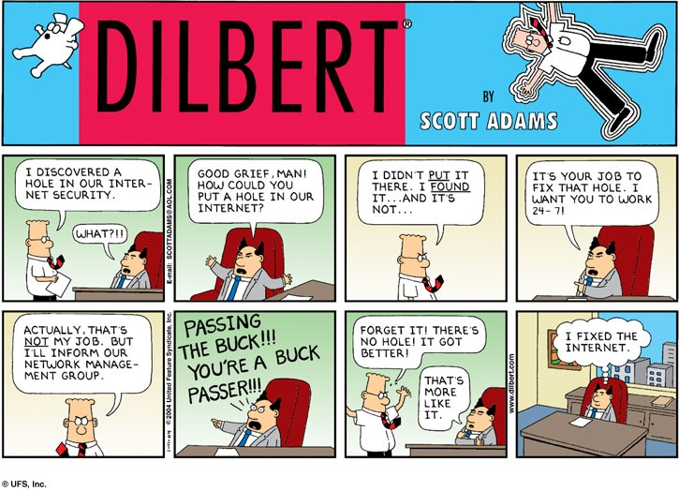

Slide 3
Research Questions
How are IT related decisions synchronized across the supply chain?
Does this differ across different types of supply chains?

Slide 4
Presentation Overview
Supply Chain Security Research
IT Governance Research
Types of Global Supply chains
Development of Conceptual Framework
Future Research

Slide 5
Supply Chain Security Concerns
Global supply chains are now a part of the war on terror
If a supply chain lets a weapon of mass destruction be shipped by container, it will cost the supply chain about $1 trillion (Eggers, 2004).
The delays at the USA and Canadian border cost well over $8 billion a year (Burke, 2005).
Focus has shifted from things taken out to things put in

Slide 6
Why Study?
Supply chain security is expensive -Increase in freight and insurance rates -32% between 2001 and 2004 (Lee 2004, Hannon 2002)
Organizations remain vulnerable
Not enough research on Inter-organizational aspects, especially IT (Croteau and Bergeron 2009)
Does not connect supply chain security to organizational strategies and supply chain types

Slide 7
Security Research Overview
Partnerships with government
Supply chain planning
Partnerships with suppliers, customers and competitors
Developing organizational capabilities
Investment in technologies

Slide 8
Defining Supply Chain Security
Application of policies, procedures, and technology to protect supply chain assets Closs and McGarrell (2004, p. 8)
  from theft, damage, or terrorism, and to prevent the unauthorized introduction of contraband,
  people, or weapons of mass destruction into the supply chain.

Slide 9
Partnerships with Government
Partnerships with government agencies has exploded
Examples
  Advanced Manifest Rule (AMR) 2003 cargo data needs to be provided to US Customs 24 hours prior to loading containers to a US-bound ship
  Customs-Trade Partnership Against Terrorism (C-TPAT) certification based on security practices for expedited US entry
  Container Security Initiative (CSI)-pushing inspections and container to upstream and loading ports

Slide 10

Supply Chain Planning
Supply Chain Continuity Planning is a part of business continuity planning (Zsidisin et al. 2005) but plans are not comprehensive
IT related continuity planning has focused on organizational IT rather than inter-organizational IT

Slide 11
Partnering
Unaware of what partners are doing for security (Ritter et al., 2007)
Partnering with competitors (Sawhney and Sumukadas, 2005
Sharing some information with some people (Closs and McGarrell 2004)
Is this one size fits all?

Slide 12
Investments in Technology
RFID for supply chain visibility
Investing in backups and information security (Prokop 2004, Helferich and Cook 2002)
GPS tracking and reporting
How to ensure that the partners are investing in firewalls, anti-virus, encryption programs and information security policies?

Slide 13
Organizational Capabilities
Communication and information sharing: Security and Logistics work like silos (Helferich and Cook 2002)
Inventory risk mitigation strategies such as buffering(Knight 2003)
Process standardization (Sheffi 2005)
Linking security to rewards (Quinn 2003)
IT governance and organizational security capabilities?

Slide 14
IT Governance
Focuses on who makes IT decisions and how(Weill 2004)
It is about the locus of control of IT decisions
  related to infrastructure, use, project management, standards etc(Sambamurthy and Zmud 1999, Peterson et. al 2000)

Slide 15
Centralization Decentralization Debate
Centralization leads to specialization, Scale economies, standardization and increased risk (Peterson 2004)
Decentralization leads to flexibility but variance in standards
Conclusion –most organizations have a federal model where they centralize infrastructure decisions and decentralize business application decisions

Slide 16
IT Governance Research
Centralization debate only focuses on where decisions are made
  Most organizations have federal models
How to we integrate federal IT decisions in supply chains?

Slide 17
Integrating Global IT Decisions
Structural integration-liaison roles and teams
Process integration aka Formalization, standardization and codification
Relational integration-consensus, persuasion and common learning
  (Peterson 2004)

Slide 18
Integrating Security Decisions
Structural integration
  Institutionalized teams with suppliers to make decisions related to IT infrastructure and security
  Committees and inter-organizational liaison roles
Process integration
  Partnering with suppliers to enforce standards
  Working with Government to ensure CTPAT rules are formalized and imposed through IT systems
  Formalizing a disaster recovery plan for all supply chain partners
Relational integration
  Joint training of with supplier staff for IT related risks
  Inter-organizational reward systems that emphasize security awareness
  Collocation and frequent communication

Slide 19
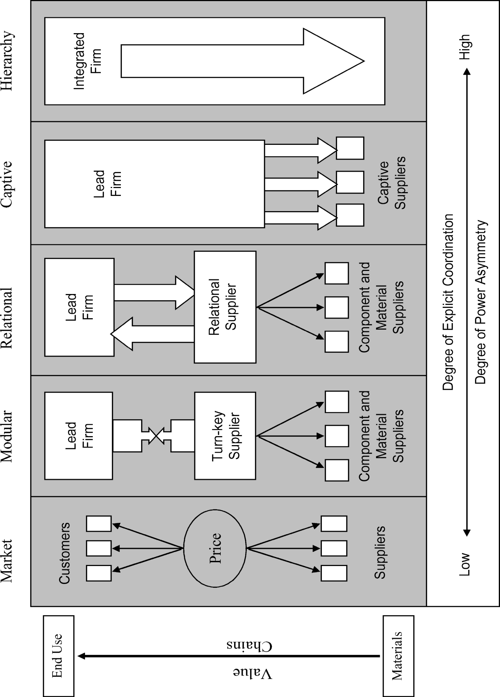
Types of Supply Chains
(Gereffi, Humphrey and Sturgeon 2005)

Slide 20
Implications
Locus of control for IT governance decisions is likely to be decentralized to supply chain partners for market and modular supply chains
  Main sources of integration is the formalization and codification of security related rules at points of handoffs
  In market based exchange, if relationships are transitory formalization may be minimal

Slide 21
Implications
For Relational supply chains
  Locus of control for security decisions will be shared
  Informal, trust and shared understanding governance based mechanisms should be used for IT governance decisions and they would also rely on structural means of integration such as cross functional teams

Slide 22
Implications
For Captive Supply chains
  The focal organization can enforce security decisions
  Process standardization and formalization can be imposed for IT governance

Slide 23
Implications
For hierarchies
  The LOC is centralized in the focal firm
  Structural and relational integration mechanisms can be used for integration (common understanding and team based functions)
  The necessity for codification and standardization of every aspect of governance and security decision making is likely to be lower than in hands-off relationships

Slide 24
Conceptual Framework
Supply Chain Type | Locus of Control | Structural Integration | Process Integration | Relational Integration
Market | Decentralized | Low | High | Low
Modular | Decentralized | Low | High | Low
Relational | Shared | High | Low | High
Captive | Centralized | Low | High | Low
Hierarchy | Centralized | High | Low | High

Slide 25
Research Direction
Identify and analyze case studies that provide examples of how the LOC and governance of these decisions varies across different types of supply chains

Slide 26
Additional Slides

Slide 27
Supply Chain IT Governance Decisions
  IT infrastructure integration
    Use of client server, EDI security, Interoperable infrastructure
  Application Integration
    Use of middleware, XML, web services and security of interconnected processes
  Data integration
    Integrating RFID and security data, common data definitions

Slide 28
