Slide 1
Adding Practical Security to Your Computer Course
Dr. Mark Ciampa
Western Kentucky University

Slide 2
150,000,000
Number of additional cars that Toyota is recalling for accelerator pedal entrapment
How many hits on Charles Barkley’s I May Be Wrong But I Doubt It video
Number of computers remotely controlled by attackers

Slide 3
214
The number of violations found by the NCCA against the University of Tennessee
How many mouse clicks are needed to navigate the Course Technology Web site
Number of Apple security patches released in 3 weeks

Slide 4
41
How many of your students who still send you e-mails with text message spelling
The number of different predictions of which NFL team Cam Newton will play for
Percentage of successful infections from USB drives
Notes:
In-the-wild malware continues to abuse AutoRun to compromise PCs,
Microsoft said. Four of the top 10 malware families in the last quarter of
2010 use AutoRun, among other techniques, to spread. Those four families
accounted for 41% of all successful infections in the last three months of
2010.
Others see AutoRun as a major threat, too. Last August, Panda Software
said that 25% of all worms were designed to propagate through the handy
drives.

Slide 5
$9.3 Billion
Average CEO salary in 2011
Average college president salary in 2011
Amount of money lost in the U.S. to the “Nigerian General” fraud scheme last year
Notes:
Okpako Mike Diamreyan, 31, was sentenced to 12 years in prison last week by United States District Judge Janet Hall in Bridgeport, Connecticut. Diamreyan, who had immigrated to the U.S. in 2008 after allegedly telling a friend that he intended to make at least $1 million before returning to his home country, was arrested in August 2009 and found guilty by a jury in February. Pretending to be "Prince Nana Kamokai of Sierra Leone" or "an airport director from Ghana", Diamreyan would send thousands of e-mails asking for help in moving money from Nigeria to the U.S. By using fake documentation to convince his victims that he was legitimate, Diamreyan would persuade them to wire to him fees to cover "courier services" or as "PIN code fees". Of course, the money would pour into Diamreyan but the victims never saw a cent. From 2004 until his arrest in 2009 Diamreyan made more than $1.3 million from 67 known victims.
Yet this was only a drop in the bucket for this scam known as the Nigerian 419 Advanced Fee Fraud ("419" is the Nigerian criminal code that addresses fraud). To date it is estimated that over $41 billion dollars have been lost by victims in this scam, with $9.3 billion lost in just 2009 alone (according to the FBI this scam was the #1 type of Internet fraud last year), and is growing at a rate of 5% annually.

Slide 6
50%
How much your retirement account lost since 2008
Price your new flat panel TV dropped the week after you bought it
Percentage of Americans who had their credit card or SSN exposed online
Notes:
500 million as of August 2010

Slide 7
39 Seconds
Time it took the person sitting next to you at breakfast this morning to inhale that donut
How often you keep checking your watch to see when this presentation is finally over
Frequency a computer is probed on the Internet

Slide 8
More Bad News
Web pages that infect by simply looking at them (6,000 new infected pages daily, or 1 every 14 seconds)
More attacks originate in U.S. than any other country (33%)
Home users were the most highly targeted sector (93% all targeted attacks)
An infected U.S. computer has an average of 8 instances of malware
U.S. has highest number of infected computers

Slide 9
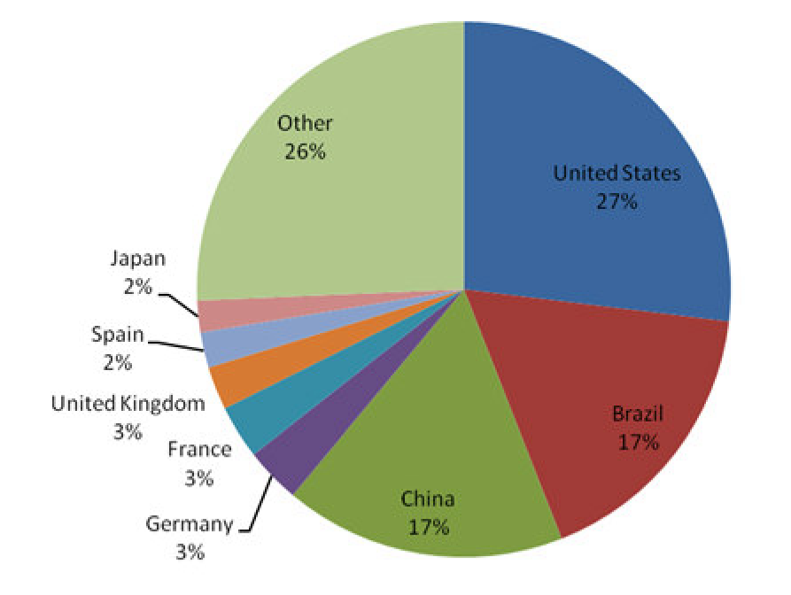

Slide 10
Dramatic Changes
Attack targets
Attack methods

Slide 11
10 Years Ago: Fame
Individual local hackers
Wanted show off abilities
Created nuisance worms and viruses

Slide 12
Today: Fortune
Organized international groups
Motive is financial gain
Steal confidential information instead of destroy
Create customized malware
Blend multiple attacks

Slide 13
Common Denominator?
IE Drive-By Download
Stuxnet Worm
Binary Planting

Slide 14
IE Drive-By Download
User receives an e-mail contains link to web site been compromised & tricked into clicking it
Link points to a web page that contains script that determines user's browser
If the browser is IE6/7 then malware is downloaded that contains remote execution program
Malware opens a backdoor on the computer and contacts the attacker's remote server in Poland

Slide 15
IE Drive-By Download
Site downloads small files with ".gif" extension (which are stored on yet another compromised web server that owner does not know has been compromised)
Files are not images but instead are encrypted files with commands telling the malware what to do next to the computer

Slide 16
Stuxnet Worm
“Best malware ever”
Written in multiple languages (C, C++ and other object-oriented languages)
Exploited 4 zero day vulnerabilities
Targeted Windows computers that managed large-scale industrial-control systems
Internal counter allowed it to spread to maximum of 3 computers

Slide 17
Stuxnet Worm
Infiltrated by infected USB flash drives
Stuxnet gained administrative access to other computers on network and then looked for computers running control systems
Exploited default passwords on control systems
Reprogramed programmable logic control (PLC) software to give machinery attached to systems new instructions

Slide 18
Binary Planting
Attacker plants malicious .EXE or .DLL "binary" on a remote location, such as a network share that the attacker controls
User tricked into opening a data file (like a document or .MP3) on that remote location so malicious binary launched
A user on Windows XP using IE6/7/8 will not be warned if they click on a link that automatically downloads a malicious DLL

Slide 19
Binary Planting
Because many Windows applications don't call DLLs using a full path name (C:\Windows\Microsoft.NET\Framework\sbs_iehost.dll) but instead only use filename (sbs_iehost.dll) the application could load the malicious file with the same filename as a required DLL
Microsoft said it cannot fix this binary planting problem but that developers of applications must instead fix their own applications.
Secunia has identified this vulnerability in over 175 widely-used Windows applications

Slide 20
Common Denominator?
IE Drive-By Download
Stuxnet Worm
Binary Planting

Slide 21
Common Denominator
Attackers combining technology with user ignorance and confusion

Slide 22
Why Increase In Attacks
Speed of attacks
More sophisticated attacks
Simplicity of attack tools
Faster detection weaknesses
Delays in user patching
Distributed attacks
Exploit user ignorance/confusion

Slide 23
“Ignorance”
Definition: Unintelligence, inexperience
Synonyms: Benightedness, bewilderment, blindness, callowness, crudeness, darkness, denseness, disregard, dumbness, empty-headedness, fog, half-knowledge, illiteracy, incapacity, incomprehension, innocence,, insensitivity, lack of education, mental incapacity, naiveté, nescience, oblivion, obtuseness, philistinism, shallowness, simplicity, unawareness, unconsciousness, uncouthness, unenlightenment, unfamiliarity, unscholarliness, vagueness
Antonyms: competence, cultivation, education, experience, intelligence, knowledge, literacy, talent, wisdom

Slide 24
User Confusion
Confusion over different attacks: Worm or virus? Adware or spyware? Rootkit or Trojan?
Confusion over different defenses: Antivirus? Firewall? Patches?
Users asked to make security decisions and perform technical procedures

Slide 25
User Confusion
Will you grant permission to open this port?
Is it safe to unquarantine this attachment?
May I install this add-in?

Slide 26
User Confusion
88% use their home computer for online banking, stock trading, reviewing personal medical information, and storing financial information, health records, and resumes
98% agree important to be able to know risk level of a web site before visiting it (But 64% admit don’t know how to)
92% think that their anti-virus software is up to date (But only 51% have current anti-virus software that been updated within last 7 days)

Slide 27
User Confusion
44% don’t understand firewalls
25% have not even heard of the term “phishing”, only 13% can accurately define it
22% have anti-spyware software installed, an enabled firewall, and anti-virus protection that has been updated within last 7 days

Slide 28
User Misconceptions
I don’t have anything on my computer they want
I have antivirus software so I’m protected
My IT person takes care of security here at work
My Apple computers is safe

Slide 29
Calls for Vigilance
“Securing your home computer helps you and your family, and it also helps your nation . . . by reducing the risk to our financial system from theft, and to our nation from having your computer infected and then used as a tool to attack other computers”
Janet Napolitano
Department Homeland Security

Slide 30
Calls for Training
National Strategy to Secure Cyberspace (NSSC) document, created by U.S. President’s National Infrastructure Advisory Council, calls for comprehensive national security awareness program to empower all Americans, including the general population, “to secure their own parts of cyberspace”
Department of Homeland Security, through the NSSC, calls upon home users to help the nation secure cyberspace “by securing their own connections to it”

Slide 31
Calls for Training
Action and Recommendation 3-4 of NSSC calls upon colleges and universities to model user awareness programs and materials
Colloquium for Information Systems Security Education (CISSE), International Federation of Information Processing Working Group 11.8 on Information Security Education (IFIP WISE), and Workshop on Education in Computer Security (WECS) all involved in security training in schools
Bipartisan Cybersecurity Enhancement Act would fund more cybersecurity research, awareness and education (Feb 20 2011)

Slide 32
Calls for Training
Researchers state that institutions of higher education (IHEs) should be responsible for providing security awareness instruction, including Crowley (2003), Mangus (2002), Null (2004), Tobin and Ware (2005), Valentine (2005), Werner (2005), and Yang (2001)
Security instruction and training important not only to meet current demands of securing systems but also to prepare students for employment in their respective fields
Location of security awareness instruction and training in a college curriculum should not be isolated in upper-level courses for IT majors, according to Tobin and Ware (2005), Werner (2005), and others
Instruction should be taught to all graduates as a “security awareness” course (Valentine, 2005) along with integrating it across through the curriculum (Yang, 2001)
Long (1999) advocated that security instruction should begin as early as kindergarten

Slide 33
Security Education In Schools
Teach network security to computer majors
Brief coverage of security in Introduction to Computers courses where teach definitions
Yet leaving out practical security awareness for all students

Slide 34
Security Education Challenge
Need educate all students about practical computer security awareness
Security Literacy - Why and how to make personal computers secure
“Users should be as fluent with security literacy as with Office or e-mail”

Slide 35
Objections
Students don’t care about security
I’m not a security expert to teach it

Slide 36
Recent Study
Surveyed 679 students a university and community college
First day of Introduction to Computers class
Students had received no instruction about security in class
Students had no previous computer courses at the school
Asked if specific security items were important to them

Slide 37
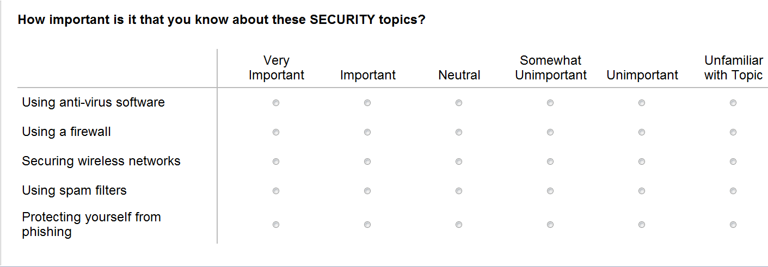
Recent Study

Slide 38
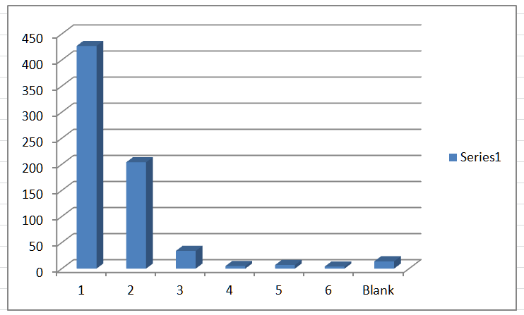
Anti-virus Software?

Slide 39
Anti-virus Software?
Response | Count |  | Question 1
1 | 427
2 | 204 |  | Mean | 1.487518
3 | 34 |  | Standard Error | 0.030121
4 | 5 |  | Median | 1
5 | 7 |  | Mode | 1
6 | 4 |  | Standard Deviation | 0.78604
Blank | 14 |  | Sample Variance | 0.617859
 |  |  | Kurtosis | 8.596261
 |  |  | Skewness | 2.437466
 |  |  | Range | 5
 |  |  | Minimum | 1
 |  |  | Maximum | 6
 |  |  | Sum | 1013
 |  |  | Count | 681
 |  |  | Largest(1) | 6
 |  |  | Smallest(1) | 1
 |  |  | Confidence Level(95.0%) | 0.059142

Slide 40
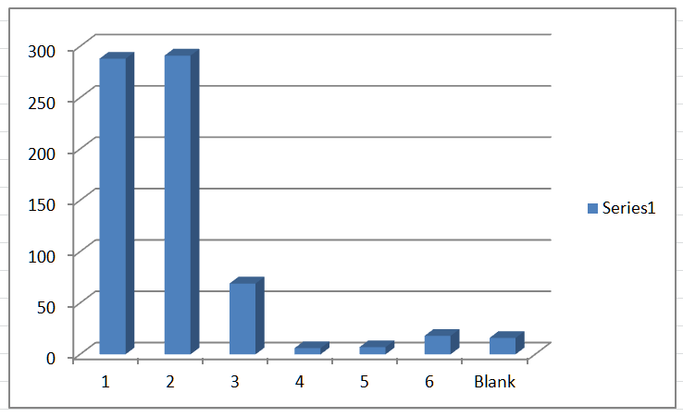
Using Firewall?

Slide 41
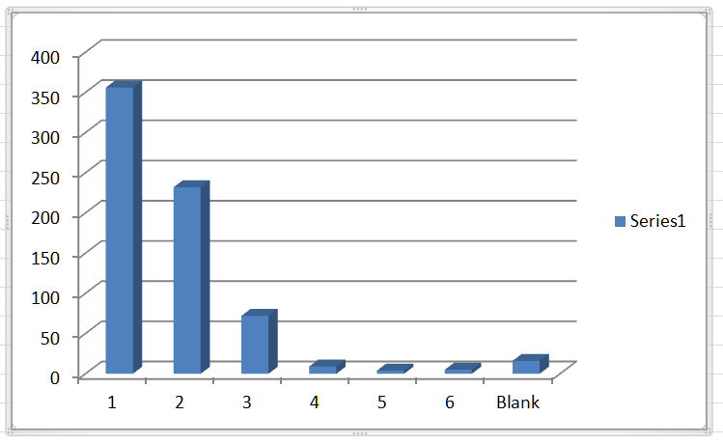
Securing Wireless?

Slide 42
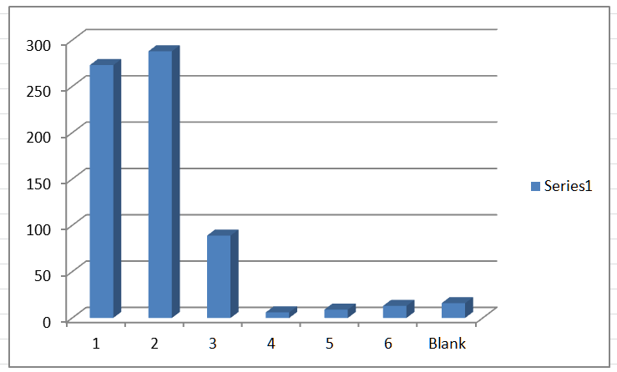
Using spam filters?

Slide 43
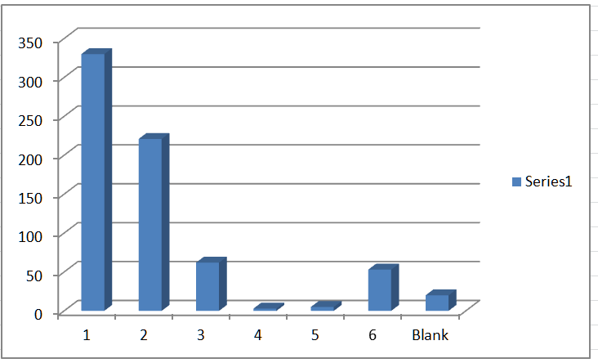
Protecting from Phishing?

Slide 44
Experts Not Needed
Attacks are targeting user ignorance and confusion
Need teach basic security awareness skills and knowledge
Should not teach advanced technology security topics
Often security experts get too carried away and need not apply!

Slide 45
Security Awareness Topics
Introduction to Security
Desktop Security
Internet Security
Personal Security
Wireless Network Security
Enterprise Security

Slide 46
Adding Practical Security to Your Computer Course
Teaching Practical Security Awareness
Desktop Security

Slide 47
What Is Information Security?
“That which protects the integrity, confidentiality, and availability of information on the devices that store, manipulate, and transmit the information through products, people, and procedures”
Security may be viewed as sacrificing convenience for safety
May be inconvenient to lock all the doors of the house or use long and complex passwords, the tradeoff is that these steps result in a higher level of safety.
Giving up short-term ease for long-term protection.
Security is making sacrifices to achieve a greater good.

Slide 48
Desktop Security
Describe the different types of software and hardware attacks
List types of desktop defenses
Explain how to recover from an attack

Slide 49
Virus
Virus – Malicious computer code that reproduces itself on the same computer
Virus inserts itself into a computer file (which can be either a data file or program)
Whenever infected program is launched looks to reproduce itself by inserting its code into another file on the same computer and performs malicious action

Slide 50
Virus
Virus can only replicate itself on the host computer on which it is located; it cannot automatically spread to another computer
Must typically rely on the actions of users to spread the virus to other computers
Because viruses are attached to files, it is spread by a user transferring those files to other devices

Slide 51
Worm
Worm - Program designed to take advantage of vulnerability in application or operating system to enter system
Once worm has exploited the vulnerability on one system, immediately searches for another computer that has the same vulnerability
Worm can travel by itself and does not require any user action to begin its execution

Slide 52
Trojan
Trojan - Program advertised as performing one activity but actually does something else (or it may perform both the advertised and malicious activities)
Typically executable programs that contain hidden code that attacks the computer system

Slide 53
Zombies & Botnets
Common malware today carried by Trojan horses, worms, and viruses
Program puts infected computer under remote control of an attacker without user’s knowledge
Zombie - Infected “robot” computer
Botnet - Thousands of zombies manipulated under remote control
Once under the attackers control botnets can be used to attack other computers

Slide 54
Personal Firewall
Two-way personal software firewall - Inspects network traffic passing through it and denies/permits passage based on rules
Firewall restricts what can come in and go out of computer across the network
  Stops bad stuff from coming in
  Stops a compromised computer from infecting other computers on network
Application-aware firewall allows user to specify which desktop applications can connect to the network

Slide 55
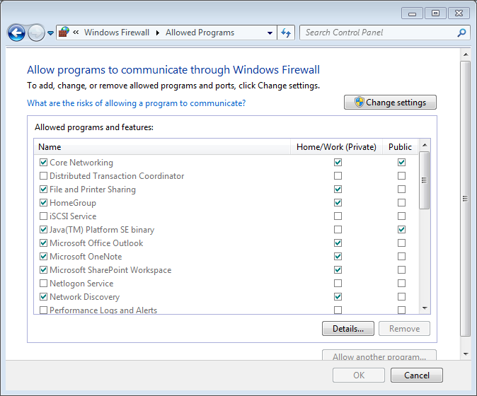
Check Firewall Settings

Slide 56
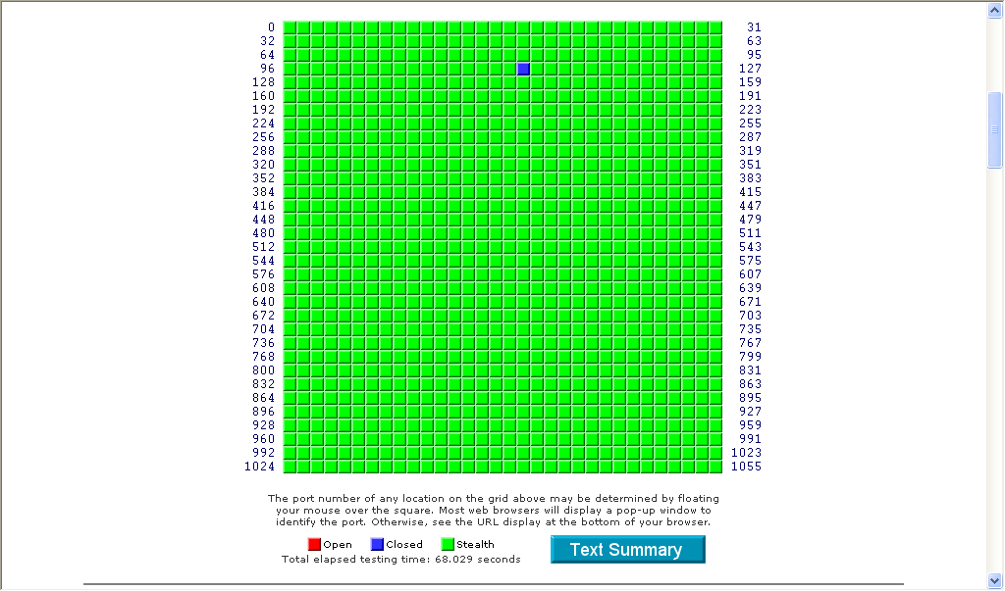
Test Firewall

Slide 57
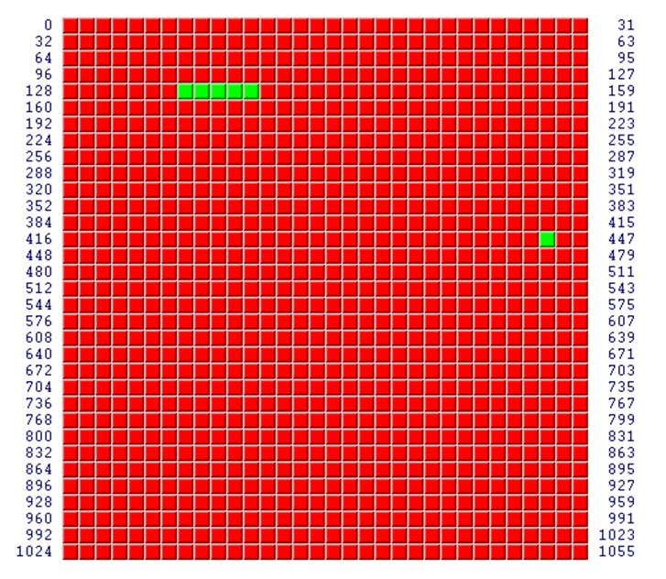

Test Firewall

Slide 58
Patch Management
Different types of patches
How to install patch
Auto-update feature

Slide 59
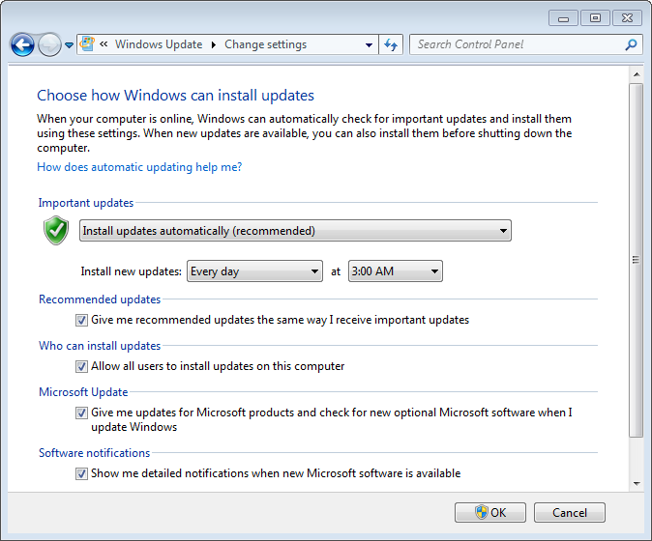
Windows Patch Updates

Slide 60
Know Your Antivirus
Know how to update
Know how to scan device
Know how to test antivirus
Know how to disinfect

Slide 61
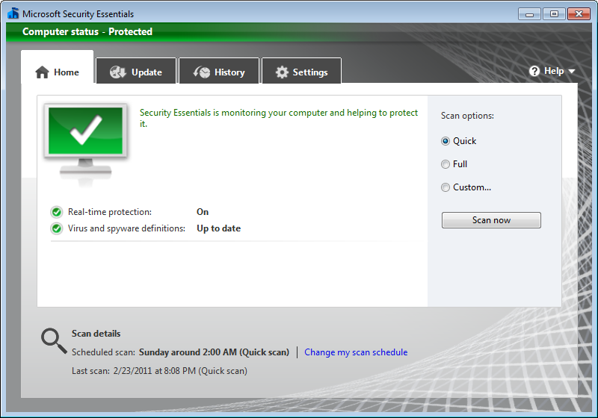
Antivirus

Slide 62
Antivirus
Test antivirus settings
Disinfect

Slide 63
Windows Action Center
Displays all system security features
First in Windows XP SP2 to constantly monitor & display status of Windows Firewall, Automatic Updates, anti-virus
Vista “Windows Security Center (WSC)” expands coverage by adding anti-spyware software, Internet Explorer security settings, User Account Control, and monitoring multiple vendors’ security solutions running and indicate which are enabled and up to date
Windows 7 renamed to “Action Center”

Slide 64
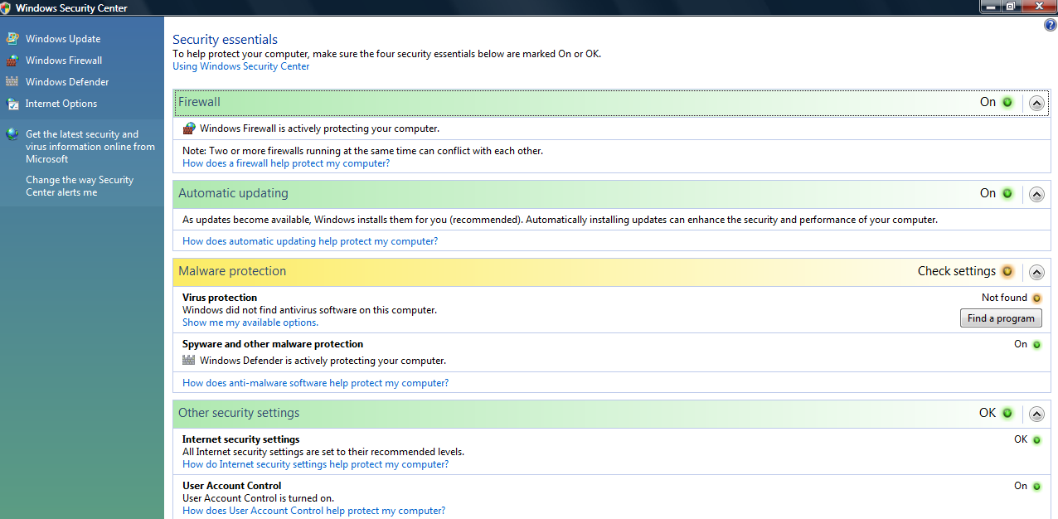
Windows Action Center

Slide 65
User Account Control (UAC)
User attempts to perform task that requires administrative access then prompted for approval or administrator password if standard user
Displays authentication dialog box must be answered before continuing
  Administrators - Click Continue or Cancel
  Standard users - Enter admin password

Slide 66
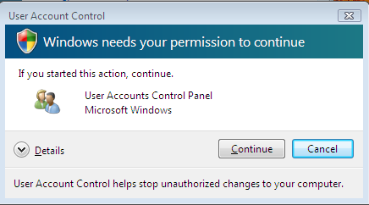
User Account Control (UAC)

Slide 67
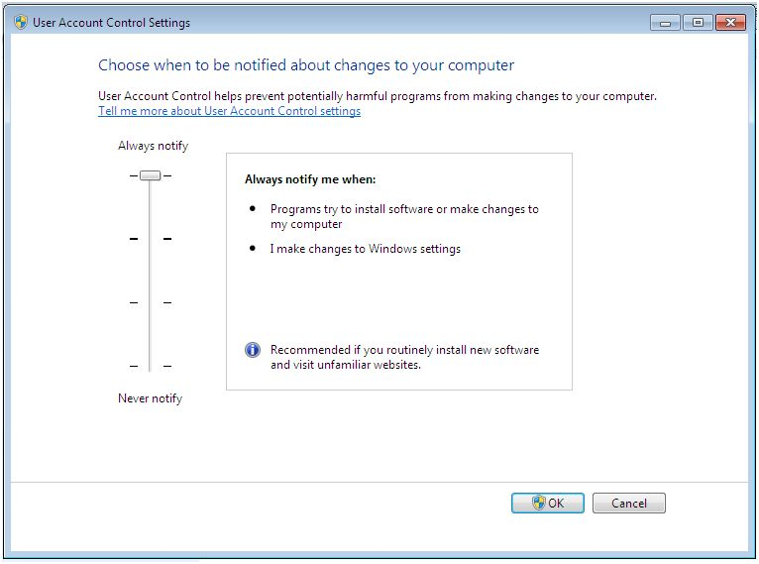
User Account Control (UAC)

Slide 68
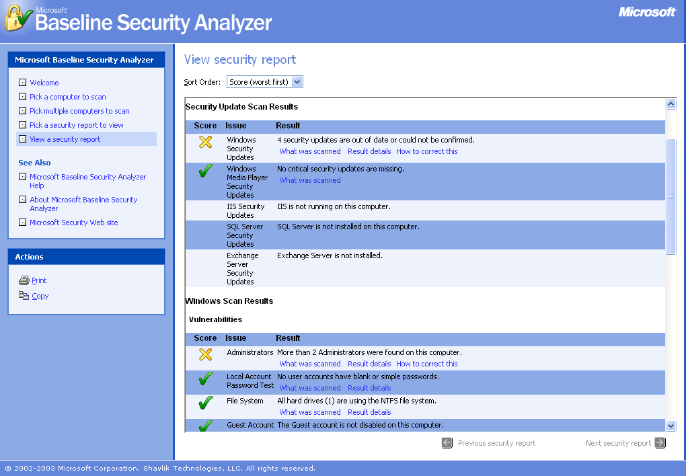
Baseline Security Analyzer

Slide 69
Secunia Software Inspector

Slide 70
Desktop Summary
Check your firewall
Turn on automatic updates
Know your antivirus
Watch UAC
Use automated inspectors

Slide 71
Adding Practical Security to Your Computer Course
Teaching Practical Security Awareness
Internet Security

Slide 72
Internet Security
Explain how the World Wide Web and e-mail work
List the different types of Internet attacks
Explain the defenses used to repel Internet attacks

Slide 73
Treat E-Mail Like A Postcard
Anybody can read it – Just as anybody who’s nosy can read what’s written on a postcard, e-mail likewise can be read as it weaves it way through the Internet. A good idea is to not put anything private in an e-mail that you wouldn’t want a stranger to read.
You can only read it – The only thing you can do with a postcard is read it and then stick it on the refrigerator; it doesn’t have a return envelope so you can respond back to the sender. E-mail should also be seen as “read only”, so don’t click on embedded links or provide requested information.
It has nothing else with it – While a letter in an envelope may also contain other documents a postcard cannot, and e-mail should be treated in the same way. It’s a good idea not to accept any e-mail attachments unless the sender has notified you (and not by e-mail!) to expect it.

Slide 74
Embedded Hyperlink

Slide 75
Embedded Hyperlink
. . . you can <a href="http://www.capitalone.com">log in to Online Account Services (OAS) </a> from this e-mail
. . . you can <a href="http://www.steal-your-number.net">log in to Online Account Services (OAS) </a> from this e-mail

Slide 76
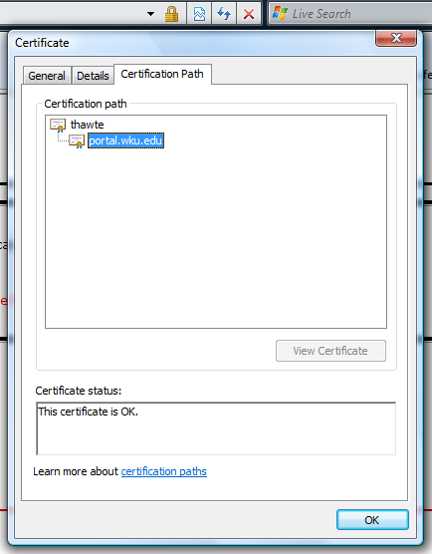
Check Certificate

Slide 77
Internet Summary
Use popup blockers
Turn on spam filters
Configure e-mail security settings
Use good e-mail practices
Check that certificate

Slide 78
Adding Practical Security to Your Computer Course
Teaching Practical Security Awareness
Personal Security

Slide 79
Personal Security
Describe attacks on personal security
Explain the dangers of identity theft
List the defenses against personal security attacks
Define cryptography and explain how it can be used

Slide 80
Password Paradox
Password paradox – For password to remain secure it should never be written down but must be committed to memory.
Password should also be of a sufficient length and complexity that an attacker cannot easily determine
Paradox: although lengthy and complex passwords should be used and never written down, it is very difficult to memorize these types of passwords.
Users have multiple accounts for computers at work, school, and home, e-mail accounts, banks, online Internet stores, and each account has its own password

Slide 81
Weak Passwords
Common word (Eagles)
Short passwords (ABCD)
Personal information (name of a child or pet)
Write password down
Predictable use of characters
Not change password
Reuse same password

Slide 82
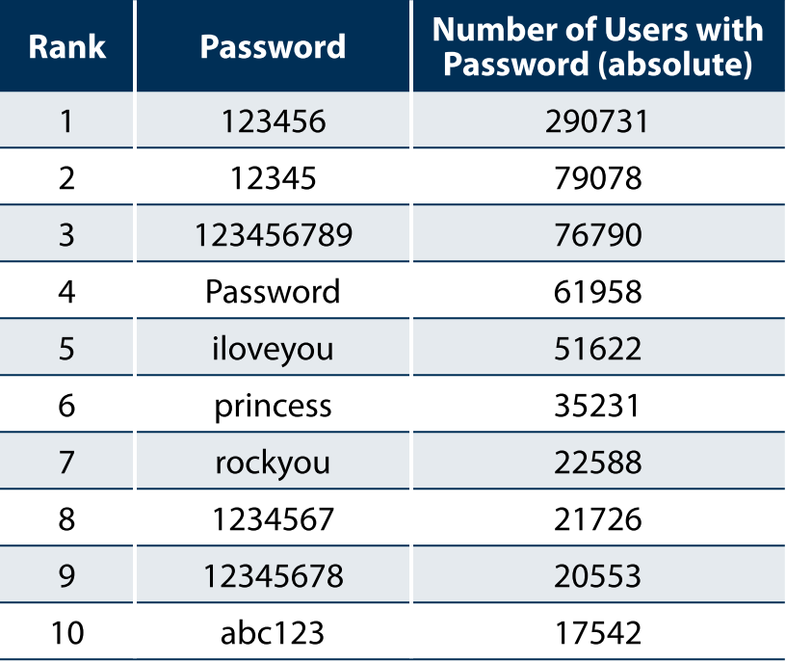
Top Ten Passwords

Slide 83
Using Strong Passwords
Strong passwords – Passwords are difficult to break
Passwords should optimally have at least 15 characters
Passwords should be a random combination of letters, numbers, and special characters
Passwords should be replaced with new passwords at least every 60 days
Passwords should not be reused for 12 months
The same password should not be duplicated and used for multiple accounts

Slide 84
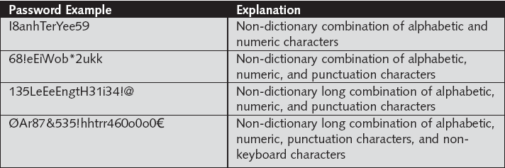
Strong Passwords

Slide 85
Password Storage Program
Password storage program – Allow user to enter account information such as username and password, along with other account details
Storage program is itself protected by a single strong password, and can even require the presence of a file on a USB flash drive before the program will open
Allows user to drag and drop usernames and passwords into these fields without the need to type them

Slide 87
Study Participants
Study was conducted at a regional university and a community college
Participants were from 1 of 4 four sections of computer courses
101 students who participated, 68 (67%) attended a university, of which 54 were male and 14 were female, while 33 (33%) students attended a community college (10 male and 23 female)
A total of 61 students (60%) were employed (54 university students and 7 community college students)

Slide 88
Instruction and Training
Users read 37-page material about personal security and password management
Users watched a 45-minute video of the material
Users took a 20-question assessment (N=101, M=16.67, SD=2.84)
Users then followed instructions how to download, install, and use a password management application
Users finally gave perceptions

Slide 89
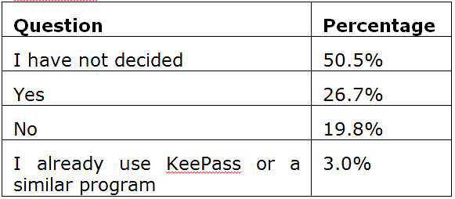
Will Use?

Slide 90
Test Passwords
All passwords should be as long as possible, using a mix of characters, and not contain any dictionary words
Develop naming convention
Online password creators
Online password graders
Online password tester

Slide 91
Phishing
Social engineering - Relies on deceiving someone to obtain secure information
Phishing - Common form of social engineering is sending an e-mail or displaying a Web announcement that falsely claims to be from a legitimate enterprise in an attempt to trick the user into surrendering private information
User asked respond to an e-mail or is directed to a Web site where instructed to update personal information, such as passwords, credit card numbers, Social Security numbers, bank account numbers, or other information for which the legitimate organization already has a record
However, Web site is actually a fake and is set up to steal the user’s information

Slide 92
Recognize Phishing Attacks
Deceptive Web links—Link to Web site embedded in e-mail should not have an @ sign in the middle of the address
  Users should never log on to a Web site from a link in an e-mail but instead should open new browser window and type legitimate address
E-mails that look like Web sites—Phishers often include the logo of the vendor and otherwise try to make the e-mail look like the vendor’s Web site as a way to convince the recipient that the message is genuine
  Presence of logos does not mean that e-mail is legitimate.

Slide 93
Recognize Phishing Attacks
Fake sender’s address—Because sender addresses can be forged easily, an e-mail message should not be trusted simply because the sender’s e-mail address appears to be valid (such as tech_support@ebay.com).
Generic greeting—Many phishing e-mails begin with a general opening such as “Dear e-Bay Member” and do not include a valid account number
Popup boxes and attachments—Legitimate e-mails from vendors never contain a popup box or an attachment
Urgent request—Many phishing e-mails try to encourage the recipient to act immediately or else their account will be deactivated

Slide 94
Phishing Tests
Mailfrontier
Antiphishing.org
Antiphishing Phil
Paypal

Slide 95
Social Networking Attacks
Grouping individuals and organizations into clusters or groups based on affiliation called social networking
Web sites that facilitate linking individuals with common interests like hobbies, religion, politics, or school contacts are called social networking sites and function as an online community of users
User who is granted access to a social networking site can read the profile pages of other members and interact with them
Social networking sites increasingly becoming prime targets of attacks

Slide 96
Social Network Defenses
Consider carefully who is accepted as a friend – Once person has been accepted as friend that person will be able to access any personal information or photographs
Show "limited friends" a reduced version of your profile - Individuals can be designated “limited friends” who only have access to a smaller version of the user’s profile
Disable options and then reopen them only as necessary - Disable options until it becomes apparent that option is needed, instead of making everything accessible and restricting access later after it is too late

Slide 97
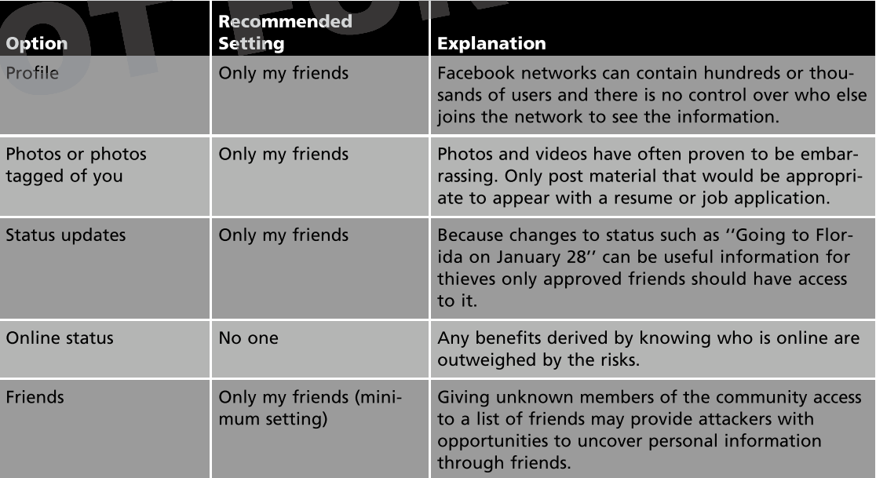
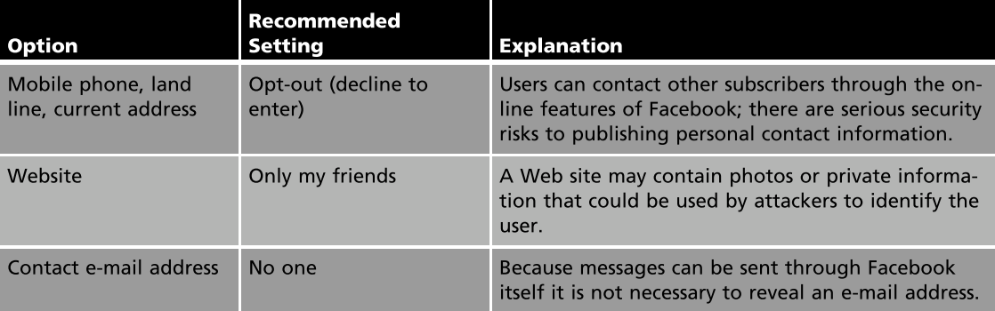

Slide 98
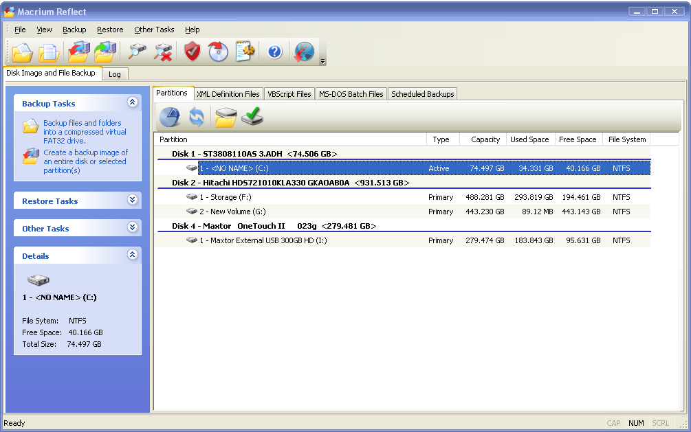
Backups

Slide 99
Personal Summary
Use a password manager
Recognize phishing attacks
Practice good social networking skills
Do regular backups

Slide 100
Adding Practical Security to Your Computer Course
Teaching Practical Security Awareness
Wireless Security

Slide 101
Does Wireless Security Matter?
Get into any folder set with file sharing enabled
See wireless transmissions
Access network behind firewall can inject malware
Download harmful content linked to unsuspecting owner

Slide 102
1. Lock Down AP
Create strong Password (>12 characters with 1 number and mixed case)
Disable Wireless Web Access (cannot access AP settings via wireless device, must be connected with cable)
Disable Remote Management (cannot access AP settings via Internet)
Access server via HTTPS (must use https://192.168.1.1) if access AP settings via Internet
Disable UPnP

Slide 103
2. Limit Users By MAC
Edit MAC Filter List by entering MAC addresses of approved PCs
Permit only PCs listed to access wireless network
Enable Wireless MAC Filter
Be sure to “Edit”, “Permit” then “Enable” or else cannot let yourself in!

Slide 104
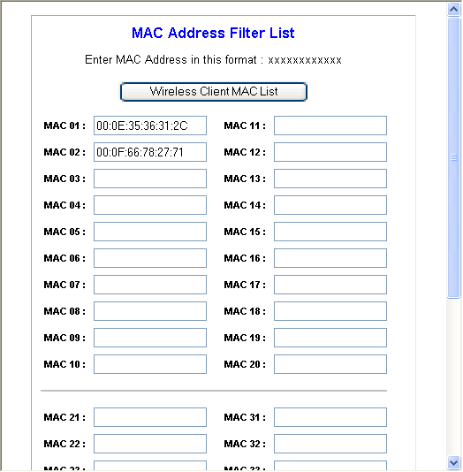
Wireless MAC Filter

Slide 105
3. Turn on WPA2
On AP Security Mode set as WPA2 Personal
WPA Algorithms set as TKIP+AES
WPA Shared Key set minimum 24 characters
Group Key Renewal should not be set to less than 300 seconds (5 minutes)

Slide 107
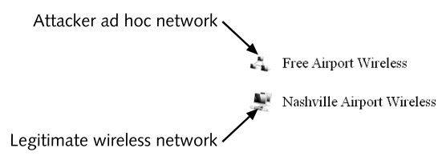
Beware of Imposters

Slide 108
Wireless Summary
Configure for security
Be aware of imposters

Slide 109
Adding Practical Security to Your Computer Course
Teaching Practical Security Awareness
Summary

Slide 110
New Approaches
Adding practical security to Introduction to Computers course
Content added to freshman orientation course
Substitute practical security course for advanced Office applications course
Adding 1 hour ethics & practical security course

Slide 111
Student Comments
As for the material presented in this class, it is great. I have found all the hands on projects to be very useful. I would recommend this class to all students. Very useful!
I have to say that I was dreading this course because I am definitely not a "techie", but I have been surprised by how much I have enjoyed it so far. I love the hands on projects!
Your class is interesting, informative, and would help anyone learn about what threats are out there, and what needs to be done to secure their system.
I'm actually having an awesome time with this class. It's kind of making me question switching my major to something more involved in the field of computer technology.

Slide 112
URL References
Test firewall - www.grc.com “Shields UP!!”
Test antivirus settings - www.eicar.org/anti_virus_test_file.htm
Disinfect - www.symantec.com/norton/security_response/removaltools.jsp
Software inspector - secunia.com/vulnerability_scanning/personal/
Online password creators - www.grc.com/passwords.htm
Online password graders - www.microsoft.com/protect/yourself/password/checker.mspx
Password manager – keepass.info
Phishing tests:
  survey.mailfrontier.com/survey/quiztest.cgi
  www.antiphishing.org/phishing_archive.html
  cups.cs.cmu.edu/antiphishing_phil/
Backups – www.macrium.com, www.todo-backup.com
Recommended free antivirus - http://www.microsoft.com/Security_Essentials/

Slide 113
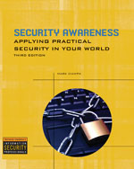
Resources
Security Awareness: Applying Practical Security In Your World (978-1-4354-5414-9)
Community.cengage.com/infosec
Mark.Ciampa@wku.edu

Slide 114
Adding Practical Security to Your Computer Course
Dr. Mark Ciampa
Western Kentucky University

